Slide 1





Can LLMs Price Optimally? Evidence from Pricing Benchmarks
Qiqi Hao², Michael Hamilton¹, Övünç Yılmaz³,
Maxime Cohen⁵, Titing Cui⁴, Alex Lim², Xindi Shao²
¹Baruch College, CUNY
²University of Pittsburgh, School of Business
³Leeds School of Business, University of Colorado Boulder
⁴Collins School of Business, University of Tulsa
⁵Bensadoun School of Retail Management, McGill University
Notes:
18 mins (20 max)
Structure: Talk about everything we do. Specify to the single product case, with many qualifications
5 mini
2.5 flash
Haiku 4.5

Slide 2
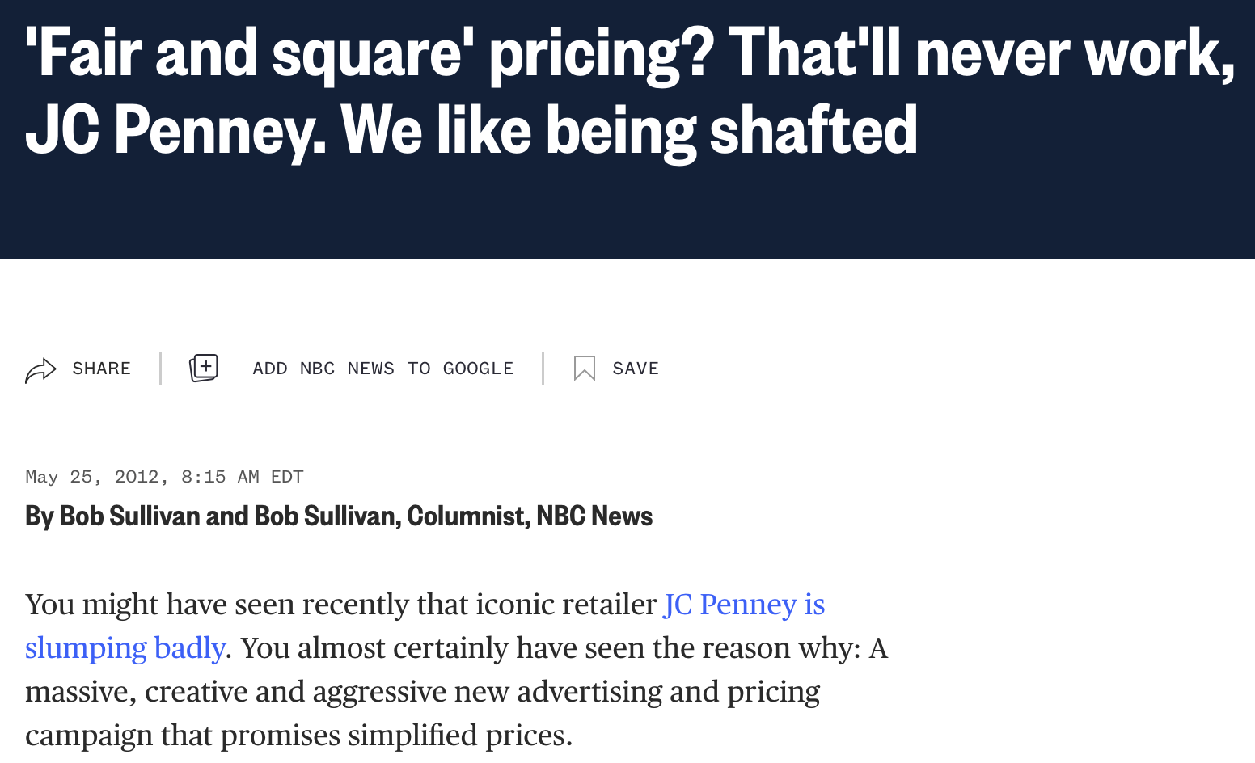

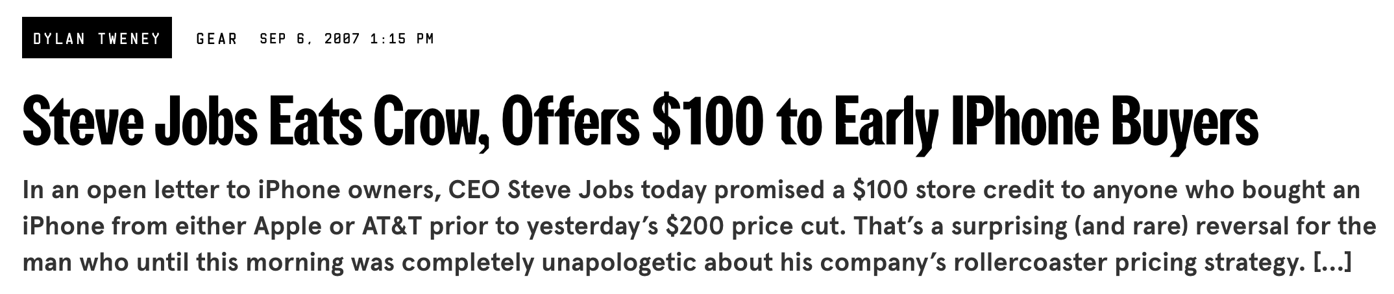
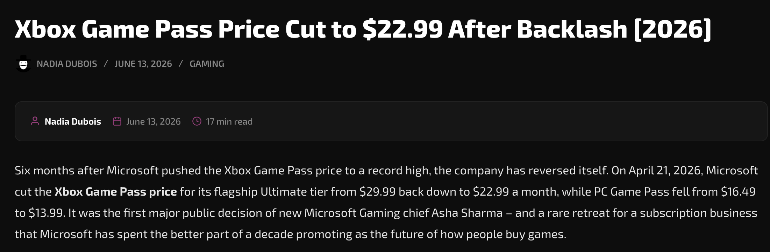
Pricing in Practice
It’s hard to overstate the importance of getting pricing right. On average, a 1 percent price increase translates into an 8.7 percent increase in operating profits. [1]
Pricing by human decision makers is challenging, high-stakes, error prone, and often ad hoc
[1] McKinsey&Co. 2014. Using big data to make better pricing decisions.

Slide 3
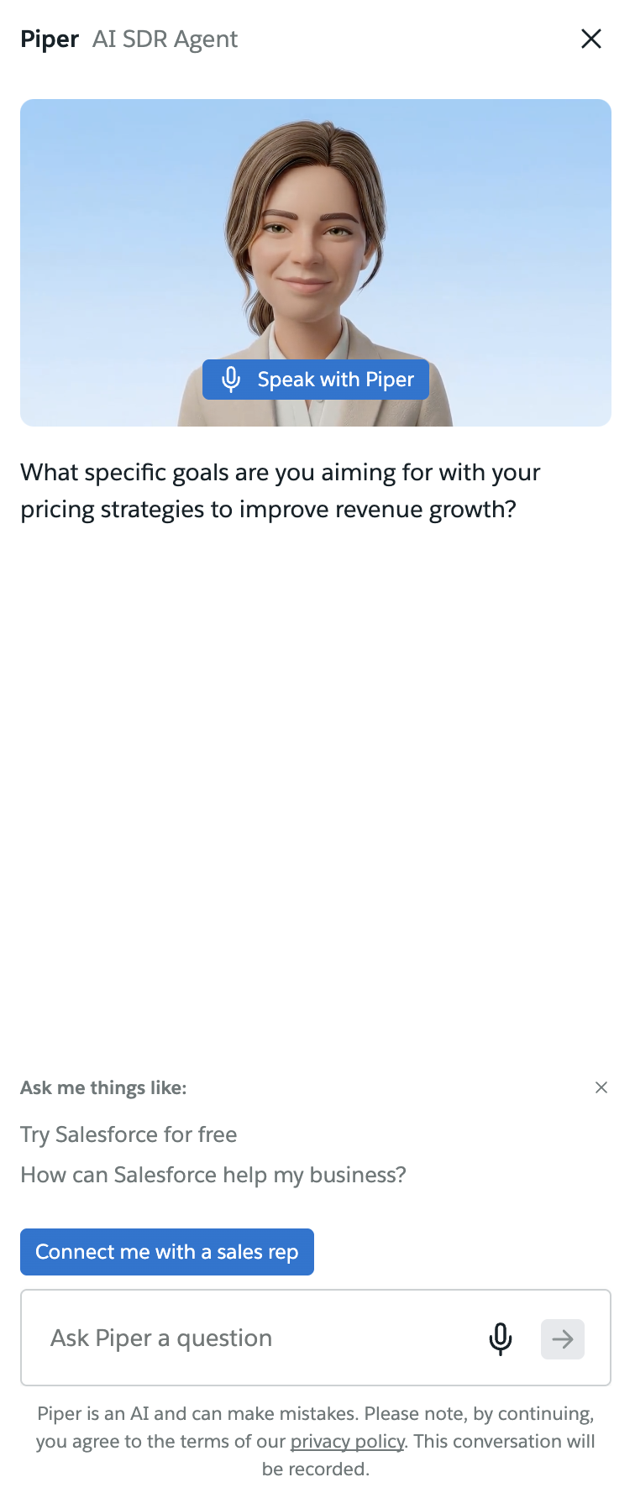
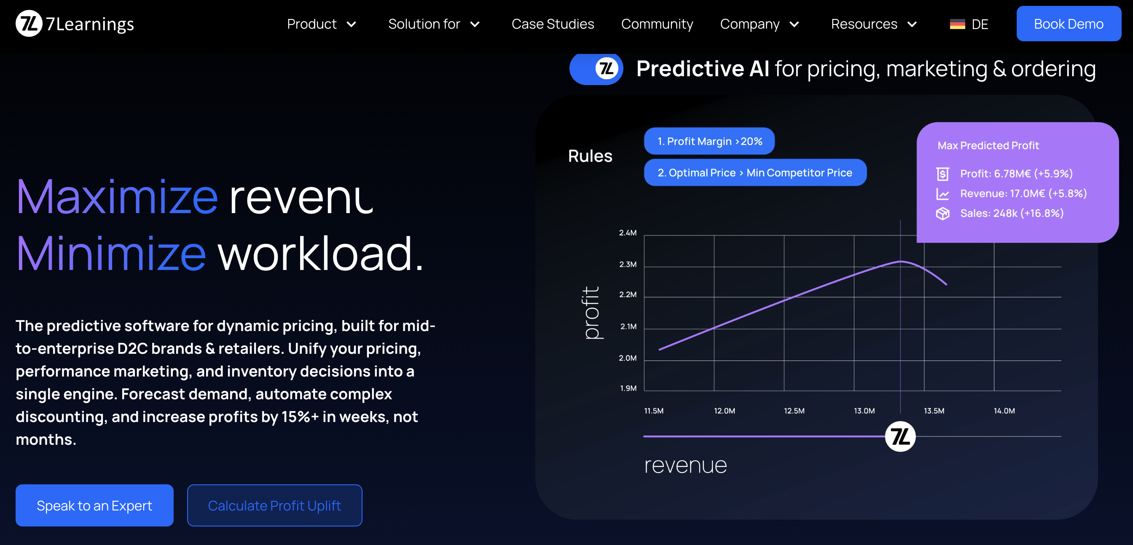
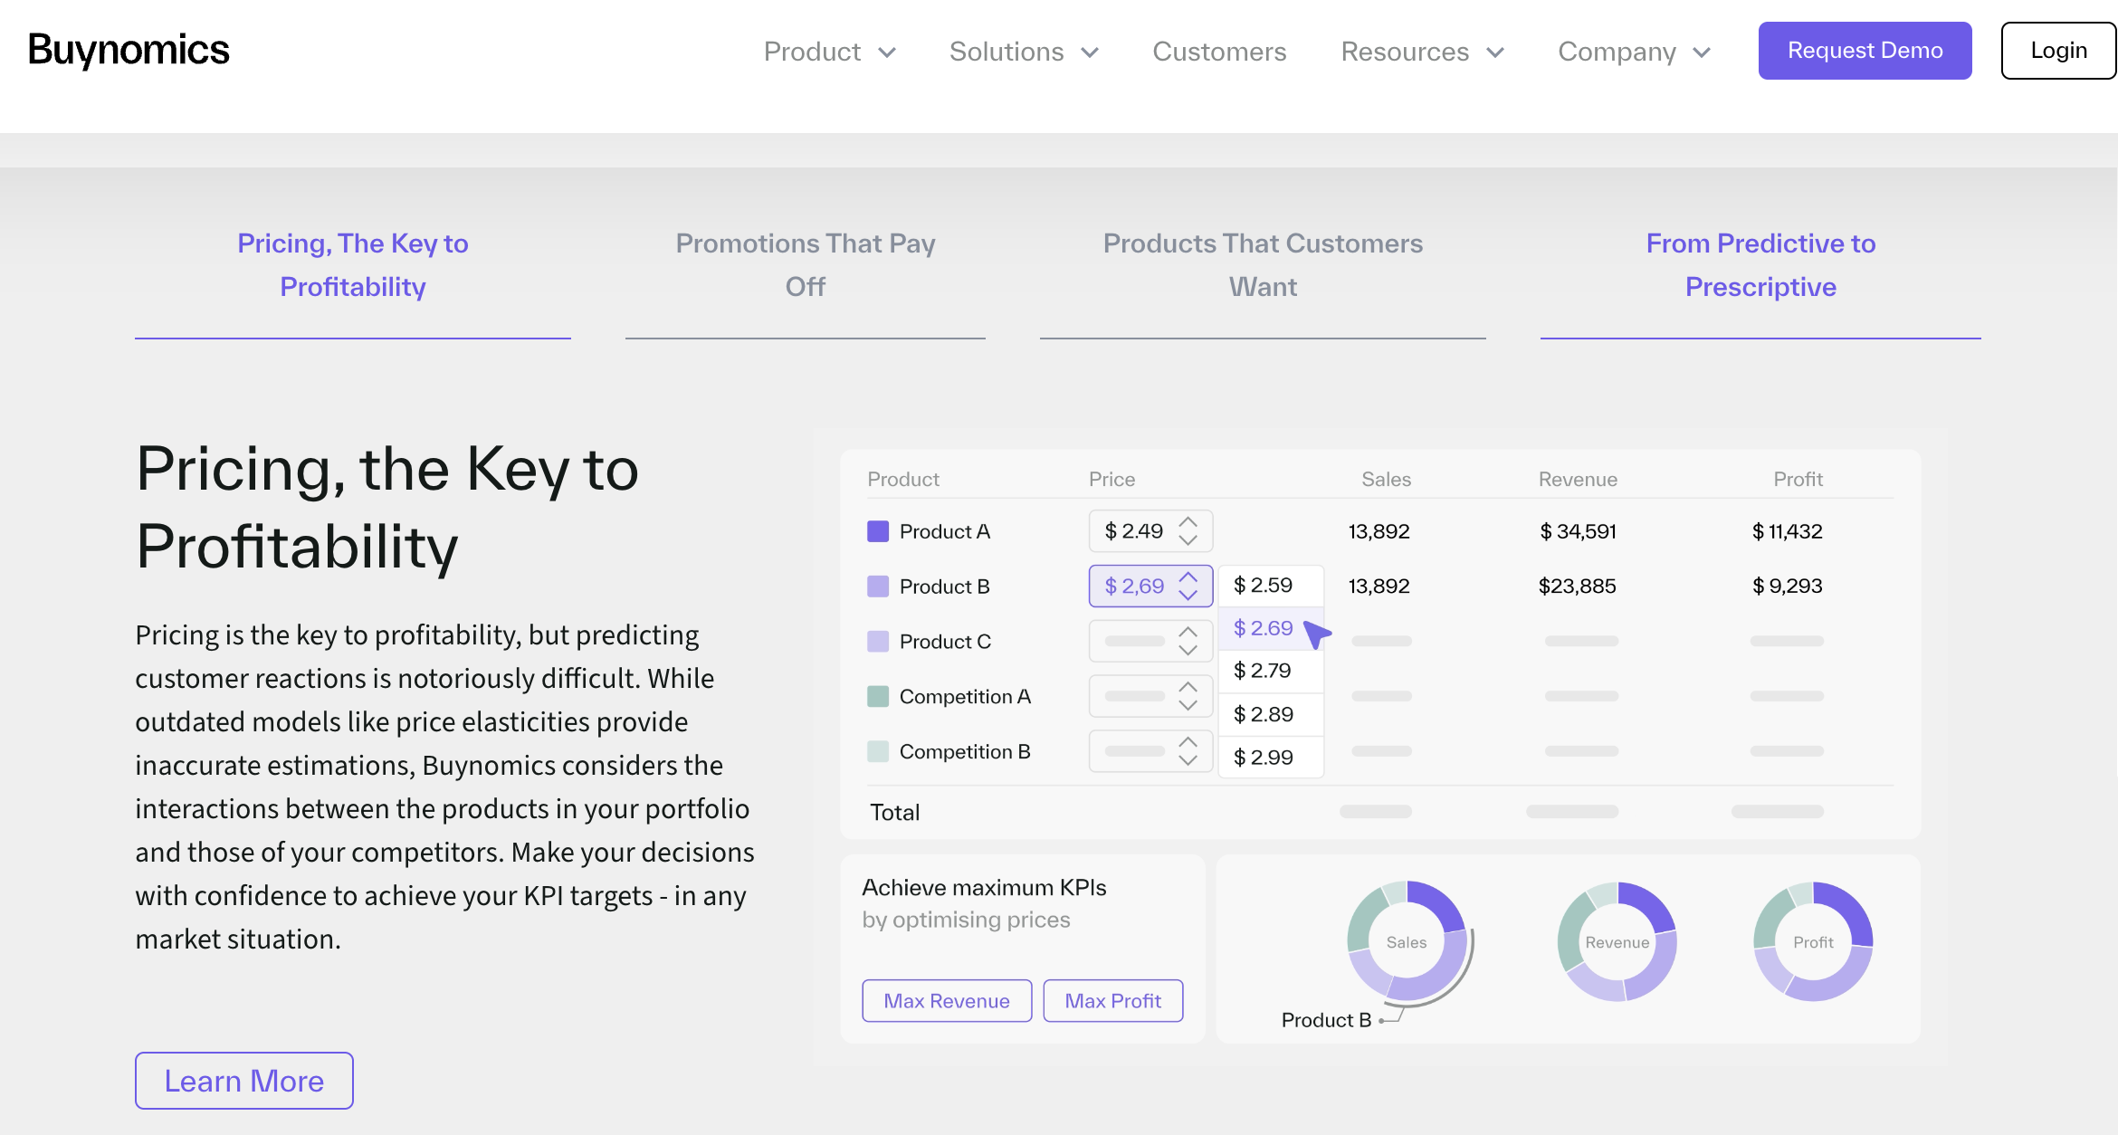
The Dream of LLM-Powered Pricing
Tremendous interest in systems that can condense contextual market information into prices
LLMs are trained a huge body of academic literature, case studies, business reports, etc. Can an LLM be the perfect pricing agent?
Ex. Start-ups 7Learnings and Buynomics
Ex. Salesforce AI-Pricing

Slide 4
Benchmarking AI-Pricing
Today you can talk with any commercial LLM, describe your problem to any level of detail, and it will suggest pricing for you to use.
In this project we measure AI’s ability to set good prices.
  Growing lit.: [1] AI Benchmark best practices, [2] Benchmarks in OR, [3] Benchmarks in Econ
Challenge: In real pricing instances, there’s often no ground truth for how you set prices.
Challenge: Pricing instances are incredibly varied across industry, product, policy, etc.
Challenge: There are many AI pricing systems each with opaque decision-making processes.
Our approach: Construct instances from (hidden) pricing and demand models and judge the AI’s ability to arrive at the good prices given price/demand histories and side information about the instance.
  Any model that could be trusted to cope with the immense complexities of real pricing should at least be able to clear our cooked instances
[1]Reuel et al. 2024. Betterbemch: Assessing AI benchmarks, uncovering issues, and establishing best practices
[2]Wang et al. 2025. Large language models in operations research: Methods, applications, and challenges
[3] Fish et al. 2016. Econvals: Benchmark and litmus test for llm agents in unknown environments..

Slide 5

Outline and Contributions
We build a large benchmark of pricing instances
We construct a benchmark of 4500+ pricing instances that vary across product context, pricing and demand relationship, history, prompt design, history length, noise level, etc.
We evaluate the performance of three leading LLMs on the benchmark
We evaluate the performance of GPT 5-mini, Gemini 2.5-Flash, and Claude 4.5-Haiku on the benchmark. We highlight which models perform well compared to a simple best-in-hindsight benchmark as well as vs. each other.
Highlight LLM pricing pitfalls
We study how LLM’s make errors on our benchmark and describe some LLM specific biases we observe.
We study LLM performance in competitive and assortment pricing environments
We construct benchmark instances for pricing relative to a competitor, and benchmark instances for joint pricing and assortment selection tasks.
We build an LLM pricing wrapper
We synthesize our insights into a wrapper for how to prompt LLMs for practical pricing tasks.
Today
Full Talk

Slide 6
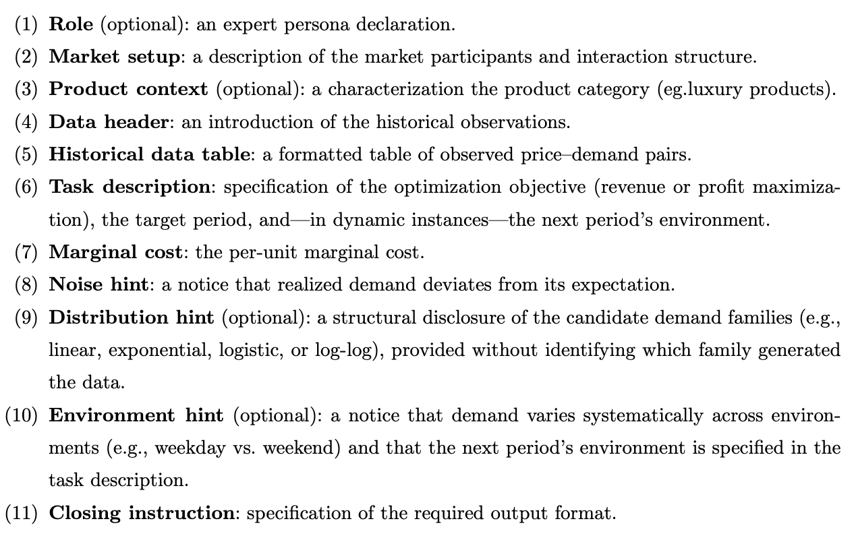
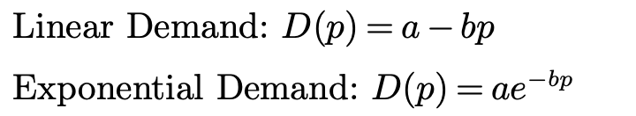
What makes a pricing instance? Single product case
Setting: One product, no inventory, no competition
Each instance has a demand function D(p) and p* = argmax R(p) = pᐧD(p)
  This forms the ground truth and is hidden from the LLM.
The LLM is given a price and demand history {p_{i} , D(p_{i}) + ε}_{i=1:n} where ε is IID mean zero noise.
  Price histories are randomly drawn from a bounded interval.
Ex. Demand Functions:
Demand function can also be time-varying
Other dimensions include:
  Role, Market Description, Product Context
  Model Hints, Environment Hints, etc.

Slide 7
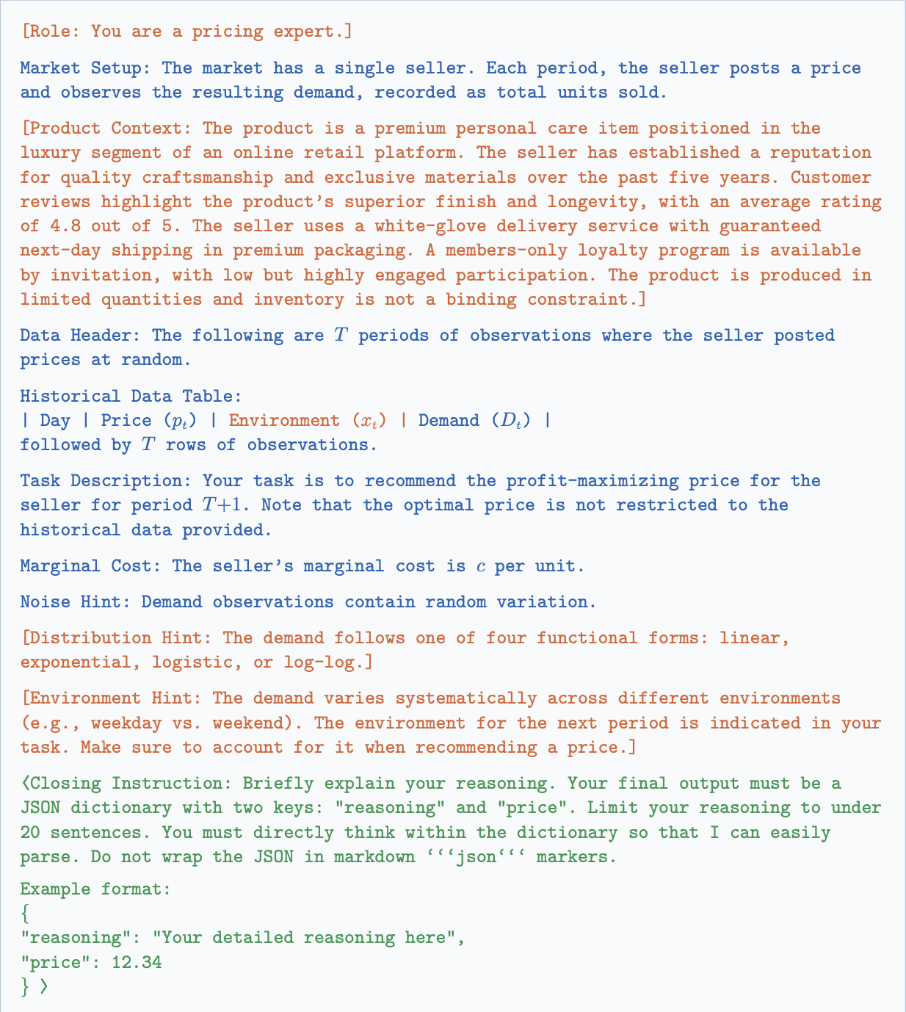
What makes a pricing instance? Single product case

Slide 8



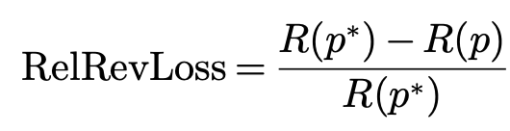
Benchmark Metrics and Heuristics
We test the performance of GPT-5 mini, Gemini 2.5-Flash, and Claude 4.5-Haiku
Our primary metric is revenue loss (RelRevLoss) of LLM price (p) relative to the optimal price (p*)
Compare with heuristic best-in-hindsight benchmark, R(p^{HIND}) = max_{i} p_{i}ᐧD(p_{i})

Slide 9
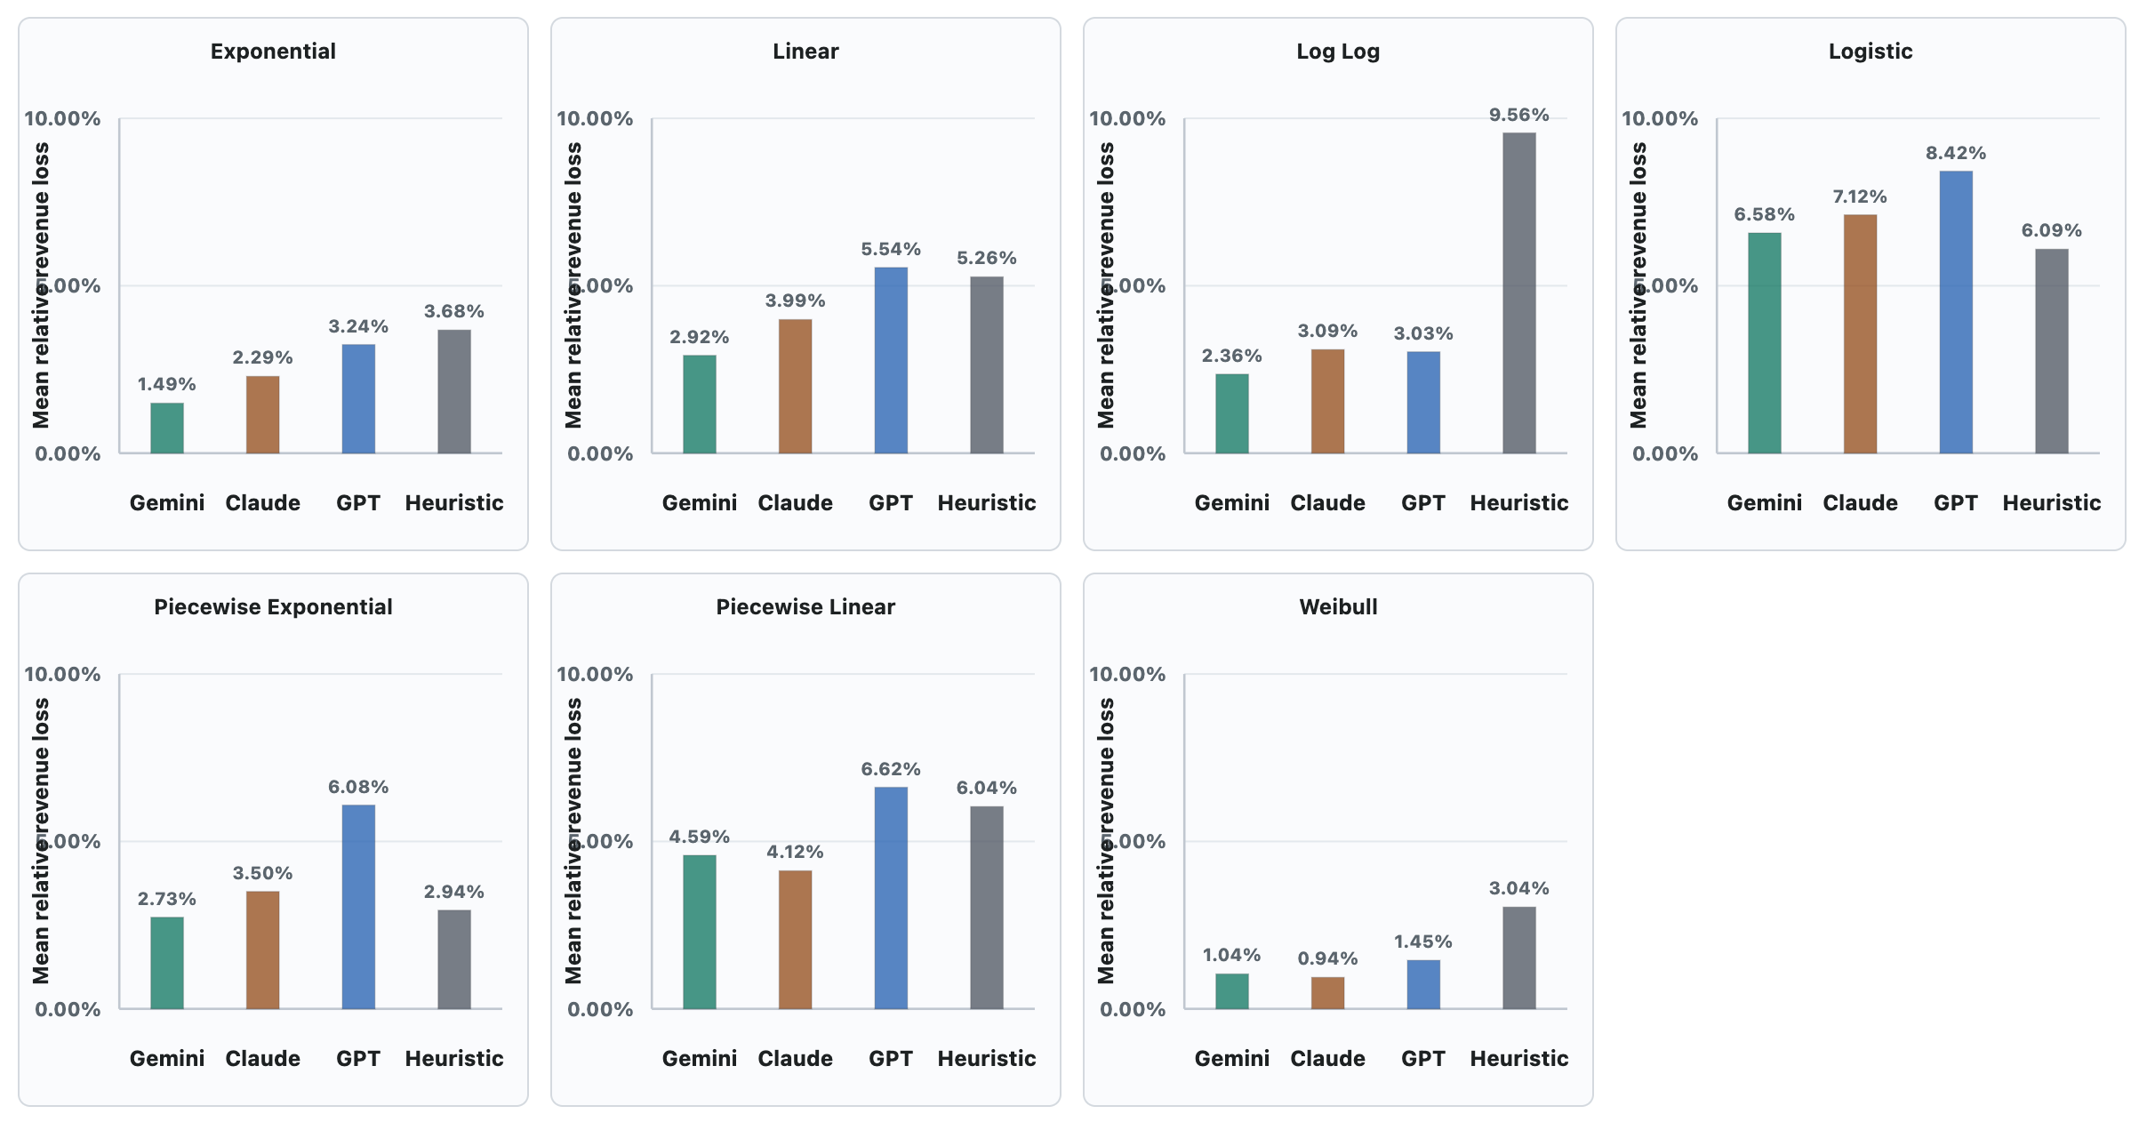
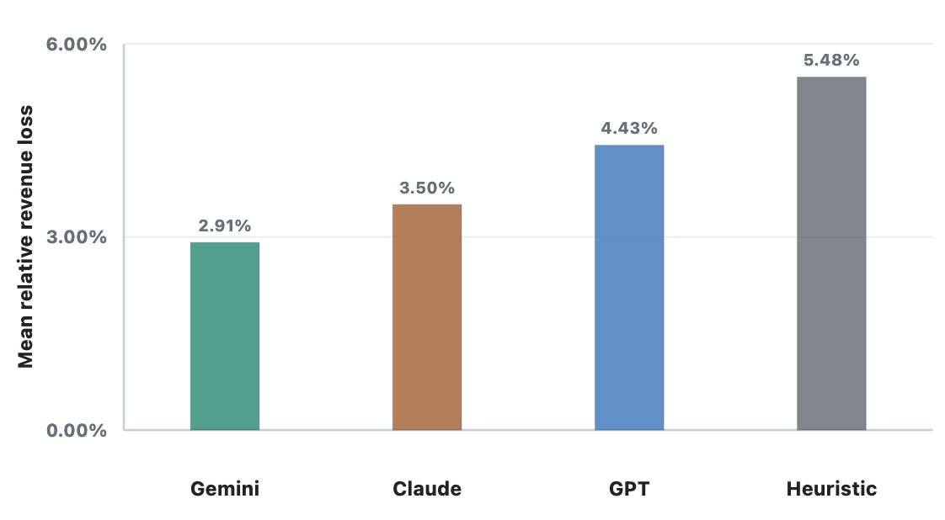
Performance Across LLMs (4500+ Instances)
All LLMs perform well and beat the best-in-hindsight heuristic representing real learning.
Overall, Gemini (2.91%) >* Claude (3.50%) >* GPT (4.43%) >* Hindsight (5.48%)

Slide 10
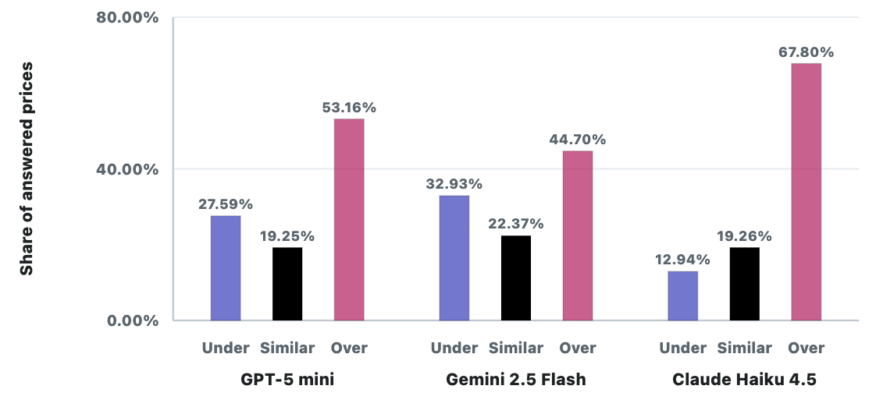
Performance Across LLMs (4500+ Instances)
All LLMs perform well and beat the best-in-hindsight heuristic representing real learning.
Overall, Gemini (2.91%) >* Claude (3.50%) >* GPT (4.43%) >* Hindsight (5.48%)
Pricing is relatively aggressive by all LLMs
  Under-pricing is 5% less than optimal, over-pricing is 5% more than optimal

Slide 11
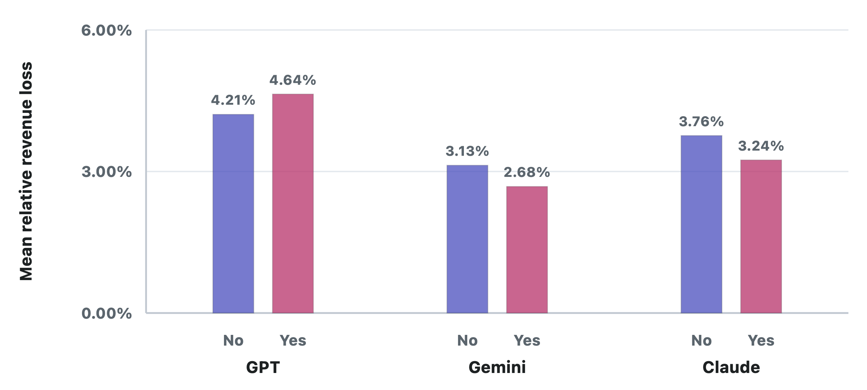
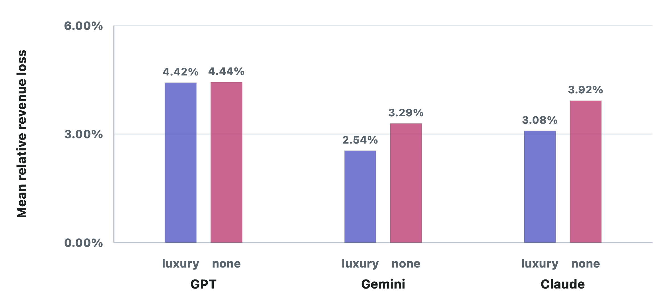
Performance Across LLMs (4500+ Instances)
All LLMs perform well and beat the best-in-hindsight heuristic representing real learning.
Overall, Gemini (2.91%) >* Claude (3.50%) >* GPT (4.43%) >* Hindsight (5.48%)
Pricing is relatively aggressive by all LLMs
Expert role (you are a pricing expert…) helps Gemini and Claude but makes GPT worse.
Product context (luxury or not) causes Gemini to increase prices (profitably), Claude to lower prices (profitably), and GPT to raise prices (no signif. effect).

Slide 12
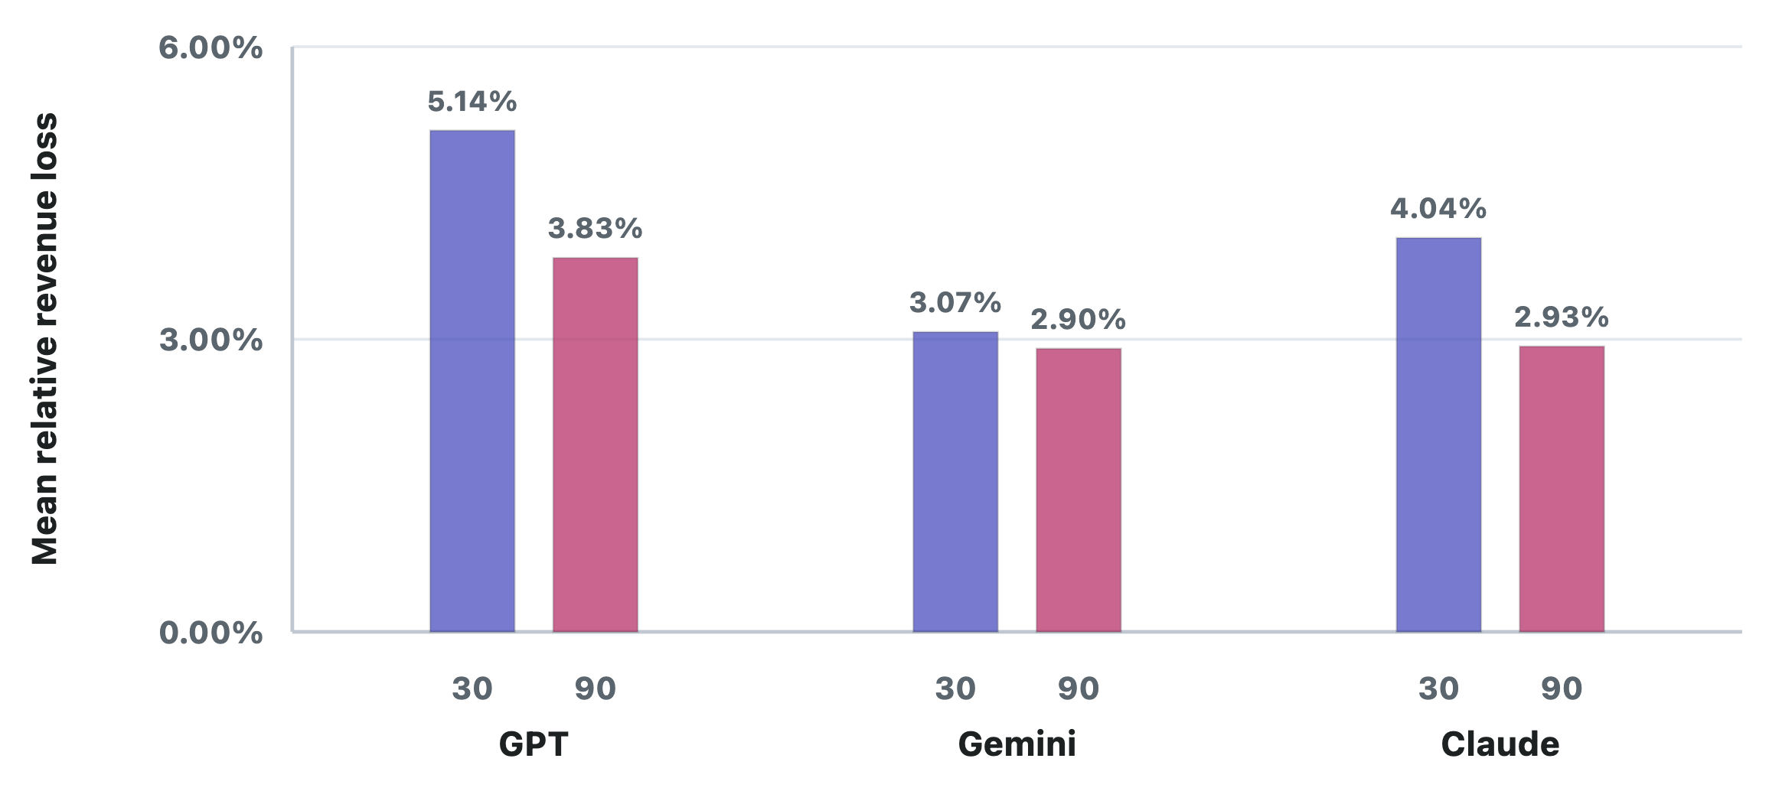
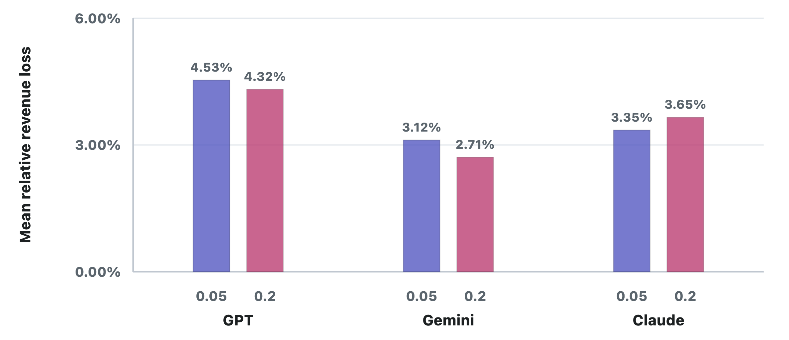
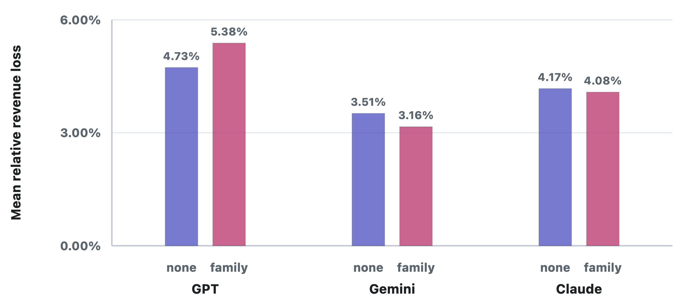
Performance Across LLMs: Oddities
All LLMs perform well and beat the best-in-hindsight heuristic representing real learning.
Moving from 30 to 90 periods cuts loss by 1.11% for Claude and 1.31% for GPT; Gemini’s change is stat. insignif.
Gemini appears to do better when demand is noisier (p-val .0337)
Giving a hint about the distribution family improves the estimates for Gemini and Claude but hurts GPT

Slide 13
Performance Across LLMs: Oddities
All LLMs perform well and beat the best-in-hindsight heuristic representing real learning.
Moving from 30 to 90 periods cuts loss by 1.11% for Claude and 1.31% for GPT; Gemini’s change is stat. insignif.
Gemini appears to do better when demand is noisier (p-val .0337)
Giving a hint about the distribution family improves the estimates for Gemini and Claude but hurts GPT

Slide 14
Performance Across LLMs: Oddities
All LLMs perform well and beat the best-in-hindsight heuristic representing real learning.
Moving from 30 to 90 periods cuts loss by 1.11% for Claude and 1.31% for GPT; Gemini’s change is stat. insignif.
Gemini appears to do better when demand is noisier (p-val .0337)
Giving a hint about the distribution family improves the estimates for Gemini and Claude but hurts GPT

Slide 15
LLM Pricing Pitfalls
We ask the LLMs to walk through their reasoning for their prices. From this, we note a few biases:

Slide 16
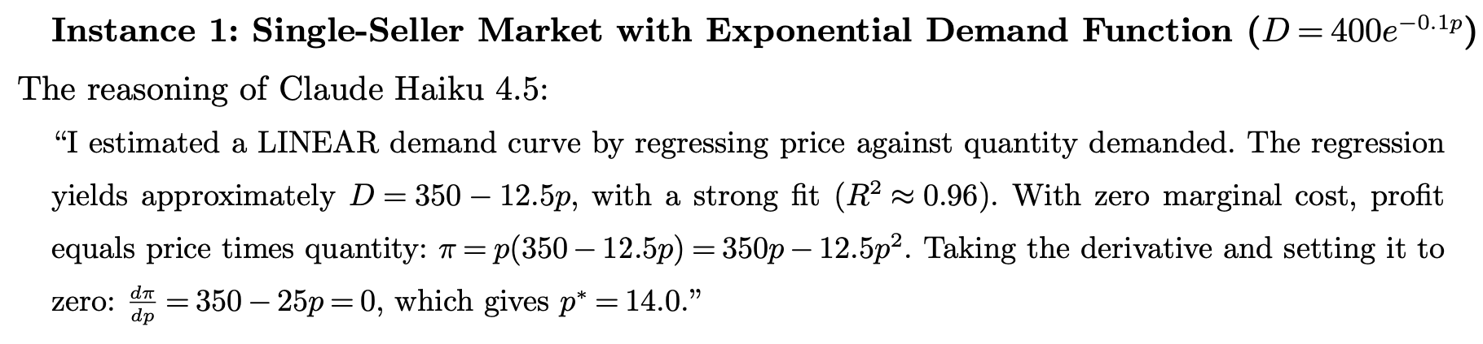
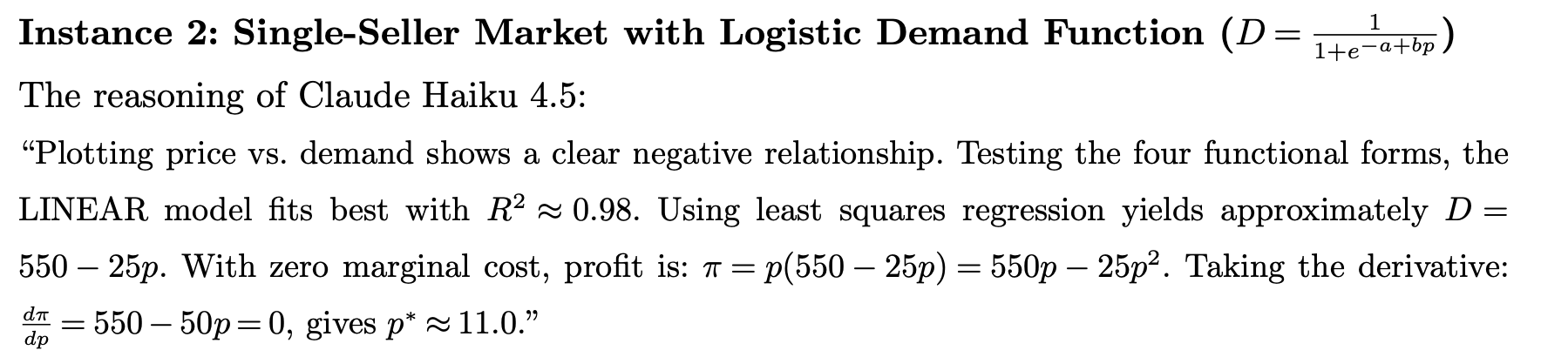
LLM Pricing Pitfalls: Linear Model Bias
We ask the LLMs to walk through their reasoning for their prices. From this, we note a few biases:
Bias 1: LLMs often default to fitting a linear relationship between price and demand, regardless of whether that fits the data as well as other.

Slide 17
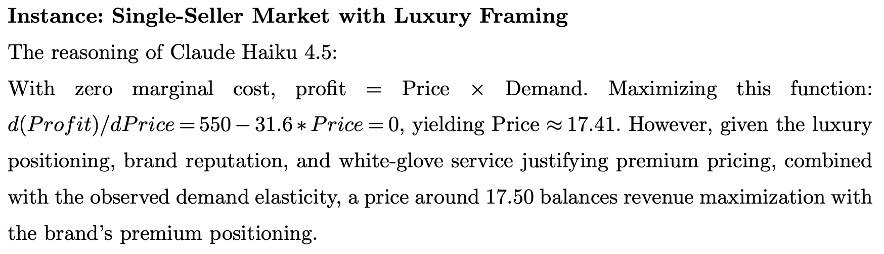
LLM Pricing Pitfalls: Context Price Fudging
We ask the LLMs to walk through their reasoning for their prices. From this, we note a few biases:
Bias 1: LLMs often default to fitting a linear relationship between price and demand, regardless of whether that fits the data as well as other.
Bias 2: Luxury pricing bias where LLMs will abandon their data-driven reasoning and modify their prices to better fit the instance context. [1]
[1] Cohen, M and Hage-Youssef, E. 2026. Confirmation Bias in LLM Pricing.

Slide 18
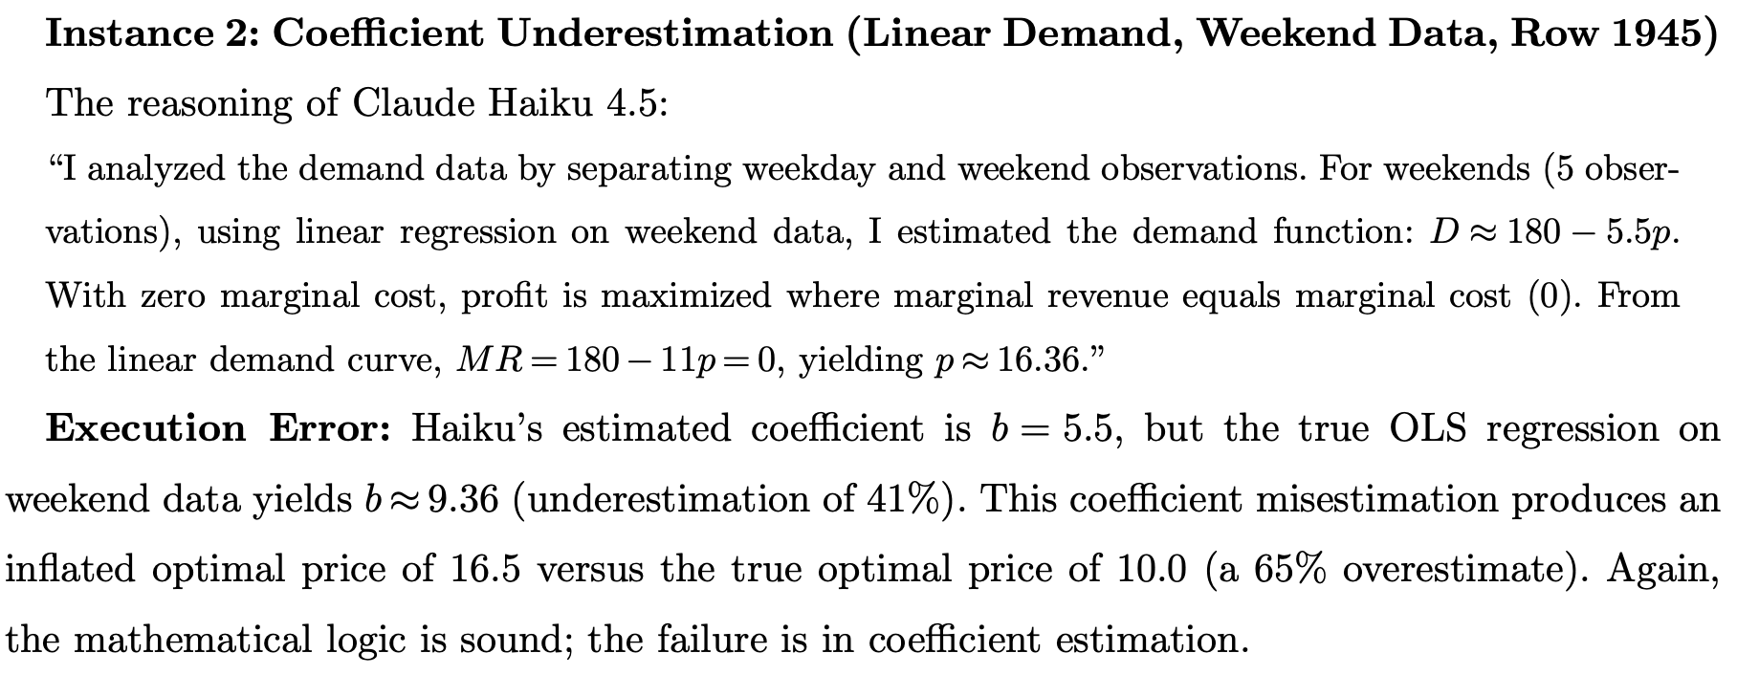
LLM Pricing Pitfalls: Execution Errors
We ask the LLMs to walk through their reasoning for their prices. From this, we note a few biases:
Bias 1: LLMs often default to fitting a linear relationship between price and demand, regardless of whether that fits the data as well as other.
Bias 2: Luxury pricing bias where LLMs will abandon their data-driven reasoning and modify their prices to better fit the instance context.
Bias 3: Execution errors where the LLM does not accurately perform the estimation it suggests.

Slide 19
Conclusions and Future Work
Conclusions
We built a large benchmark of simple pricing instances to measure LLM pricing performance.
Over these instances, the LLMs are strong pricing agents which do real learning from data.
We note significant variation in performance and ability across LLMs.
The LLMs are also highly suggestible, and struggle to blend data-driven analysis with pricing context in a principled manner.
LLMs also are biased towards fitting linear models, fudge prices to match context, and often fail to follow their prescribed price optimization.
Full Paper
We study LLM performance in competitive and assortment pricing environments and construct benchmark instances for pricing relative to a competitor, and benchmarks for joint pricing and assortment selection tasks
We build an LLM pricing wrapper We synthesize our insights into a wrapper for how to prompt LLMs for practical pricing tasks.

Slide 20

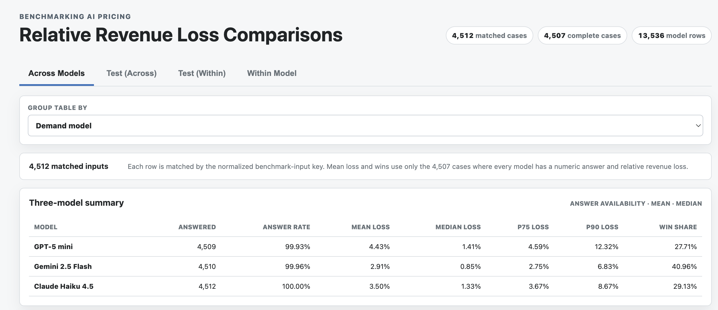

Thank You!
White paper coming soon
Website: https://ovncylmz.shinyapps.io/ai-pricing-benchmarks/
Website
Questions & Comments?
Email: mih140@pitt.edu
Website: mhamilton-pitt.github.io
Slides

